Slide 1
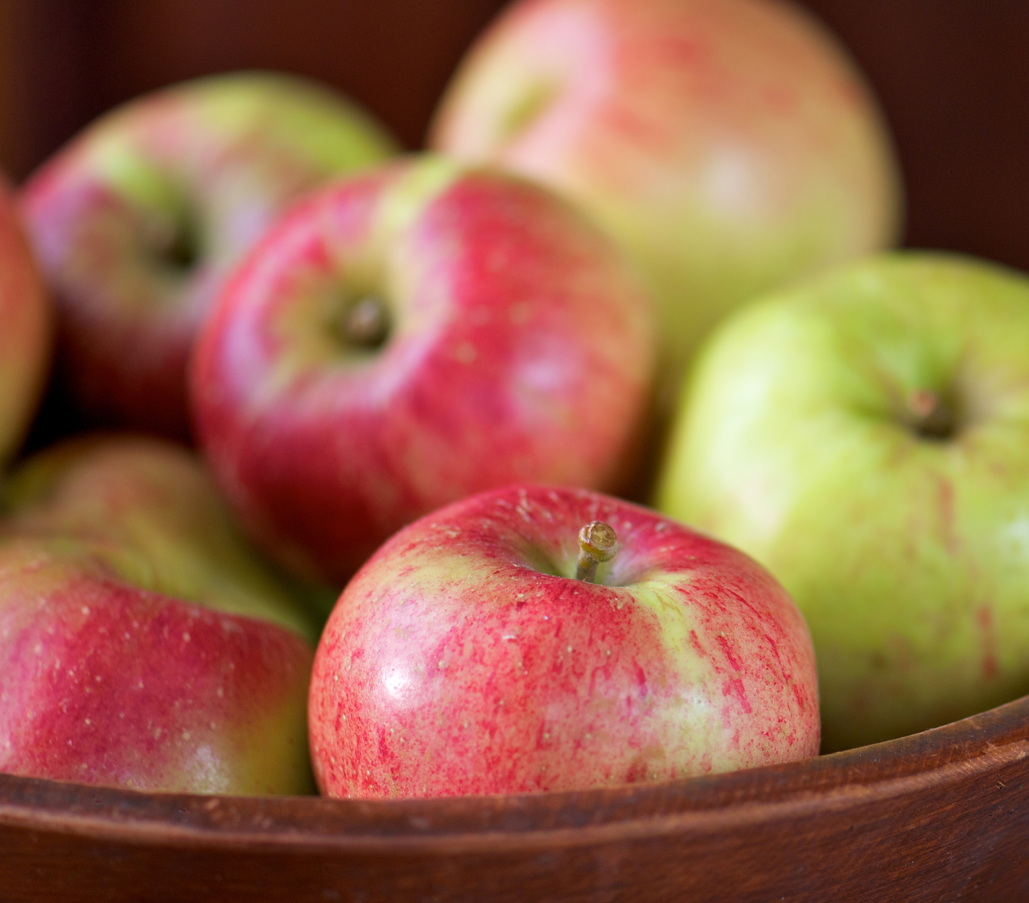
Apple Classification with PyTorch
ISM6561 Deep Learning
Kathryn Burkhart, Prince Praveen, Debjani Sarma

Slide 2
Preliminary Steps
Seed set to 42 for reproducibility
Defined transformation pipeline which:
Resize images to 128x128 pixels for uniformity
Convert images to PyTorch tensors
Normalize images using computed mean and standard deviation for stable training
Load dataset using ImageFolder
Handle class imbalance via WeightedRandomSampler (if present)
Create PyTorch DataLoader to load images in mini-batches for training
Notes:
Before training our model to classify apples, we first need to set up a solid foundation.
First, we set the seed to 42 to ensure reproducibility.
Next, we defined the transformation pipeline. This includes resizing all images to 128x128 pixels to maintain uniformity across the dataset. Then, we converted the images into PyTorch tensors so they can be used in deep learning models. After that, we normalize the images using a precomputed mean and standard deviation. This step helps stabilize training by ensuring that pixel values are centered around zero.
Once the transformations are in place, we load the dataset using ImageFolder. This automatically assigns labels based on folder names.
If the dataset has class imbalance—meaning some apple types appear more frequently than others—we address this using a WeightedRandomSampler. This ensures that all classes are sampled more evenly during training.
Finally, we wrap everything in a PyTorch DataLoader, which organizes our images into mini-batches. This helps improve training efficiency by allowing our model to process multiple images in parallel.

Slide 3

Computed Dataset Metrics: Size, Normalization, and Class Balance
Dataset size: 4,844 images of different apple types
Computed Mean and Standard Deviation:
Mean pixel values for each color channel (RGB):
Red: 0.6763, Green: 0.5651, Blue: 0.4429
Standard deviation values for each channel:
Red: 0.2441, Green: 0.2925, Blue: 0.3333
Class Distribution:
10 classes (labeled from 0 to 9)
Each class contains around 492 images, except for class 3 (481 images) and class 7 (429 images)
There was imbalance in class distributions, so WeightedRandomSampler is used to ensure fair sampling during training
Notes:
After setting up our dataset, we computed key metrics to better understand its structure.
First, the dataset contains 4,844 images of different apple types, divided into 10 distinct classes. Each class is labeled from 0 to 9.
To improve training stability, we calculated the mean and standard deviation of pixel values for each RGB channel. This helps normalize the images, ensuring that pixel values are centered around zero.
The computed mean values are 0.6763 for red, 0.5651 for green, and 0.4429 for blue.
The corresponding standard deviations are 0.2441, 0.2925, and 0.3333.
These values help maintain consistent image intensity across training.
Looking at the class distribution, most classes contain around 492 images, but there are some imbalances. Specifically, class 3 has 481 images, and class 7 has 429 images.
To address this, we used WeightedRandomSampler, which adjusts the sampling probability for each class. This ensures that underrepresented apple types are sampled more frequently during training, helping the model learn from all categories more effectively.
By computing these dataset metrics and handling class imbalance, we were able to create a more robust foundation for training our apple classification model.

Slide 4
Experiment 1: Baseline Model for Future Comparisons
Model Architecture: A feedforward neural network with two hidden layers (512 and 256 neurons, ReLU activation) and a 10-neuron softmax output layer for classification.
Input Processing: Flattened 128×128 RGB images (49,152 features).
Activation Functions: ReLU for hidden layers (prevents vanishing gradients, speeds up training), Softmax for output (converts logits to probabilities).
Optimizer & Loss Function: Adam optimizer (adaptive learning rate, momentum benefits) and Cross-Entropy Loss (suited for multi-class classification).
Evaluation Metrics: Accuracy, Precision, Recall, and F1-score for performance assessment.
Training Monitoring: Loss curve analysis (Training vs. Validation) over 10 epochs.
Notes:
For our first experiment, we designed a baseline model that serves as a reference point for future improvements.
Model Design Choices
We started by defining the input layer, where each 128x128 RGB image is flattened into a feature vector of 49,152 values (since 128 × 128 × 3 = 49,152).
Next, we built a two-layer neural network using ReLU activation in both hidden layers:
Layer 1: 512 neurons
Layer 2: 256 neurons
The output layer consists of 10 neurons, one for each apple type, and uses a Softmax activation function to convert raw outputs into probability scores for classification.
Activation Functions
We used ReLU (Rectified Linear Unit) in the hidden layers because it helps avoid the vanishing gradient problem and speeds up training by introducing sparsity—meaning it sets negative values to zero, making computations more efficient.
For the output layer, we used Softmax, which transforms raw outputs into a probability distribution, ensuring that the predicted class has the highest probability.
Optimizer & Loss Function
To train the model, we selected the Adam optimizer, which combines the benefits of adaptive learning rates and momentum, offering a good balance between speed and stability.
For the loss function, we used Cross-Entropy Loss, which is ideal for multi-class classification problems like ours. It helps the model learn how to differentiate between different apple types by penalizing incorrect predictions more effectively.
Evaluation Metrics
To assess model performance, we track:
Accuracy (overall correctness of predictions)
Precision (how many predicted positives are actually correct)
Recall (how well the model captures actual positive cases)
F1-score, which balances precision and recall to give a more detailed view of class-wise performance.
Additionally, we plot the loss curve, comparing training loss vs. validation loss over 10 epochs, helping us detect signs of overfitting or underfitting.
This baseline model establishes a foundation, and in later experiments, we can refine it by tweaking hyperparameters, adding layers, or experimenting with different architectures."

Slide 5
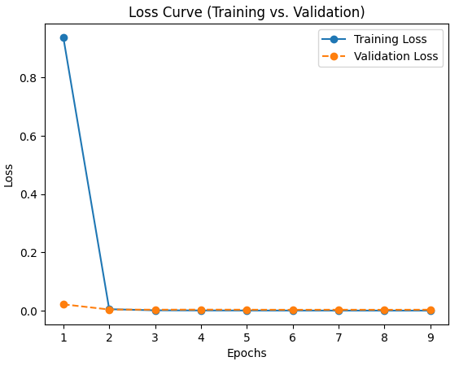
Experiment 1: Baseline Model Results and Findings
Rapid Convergence & Early Stopping: Training loss dropped sharply to near zero by epoch 9, triggering early stopping. Validation loss stabilized around 0.0028 - 0.0031.
Potential Overfitting: Extremely low training loss (0.0001) suggests the model may have memorized the training data rather than generalizing.
High Performance Metrics: Accuracy, Precision, Recall, and F1 Score all reached 99.90%, indicating near-perfect classification.
Overfitting Risk: Despite strong performance, the minimal training-validation loss gap and extremely low training loss indicate a risk of overfitting.
Notes:
After training our baseline model, we observed some interesting results.
Rapid Convergence & Early Stopping
The model's training loss dropped sharply and approached zero by epoch 9, which triggered early stopping. Meanwhile, validation loss remained stable in the range of 0.0028 to 0.0031, suggesting that the model quickly learned the patterns in the data.
Potential Overfitting
One major concern is overfitting. The training loss reached an extremely low value of 0.0001, which indicates that the model may have memorized the training data rather than learning to generalize.
High Performance Metrics
From an accuracy standpoint, the model performed exceptionally well.
Accuracy: 99.90%
Precision, Recall, and F1-score: Also 99.90%, meaning the model classified nearly all samples correctly.
Overfitting Risk
Despite the high-performance metrics, the minimal gap between training and validation loss and the extremely low training loss suggest that the model might not generalize well to unseen data. This means that while it performs perfectly on the training set, it may struggle with new apple images.
Next Steps to Address Overfitting To improve generalization in further models, we plan to introduce regularization techniques via by applying Dropout, L2 Regularization (Weight Decay), and Batch Normalization to prevent overfitting and improve robustness.
Through different activation and cost functions, we would then go on to compare ReLU, Tanh, and Sigmoid activation functions to see if a different non-linearity improves performance. In addition, we would also experiment with alternative loss functions to determine if Cross-Entropy remains the best fit.

Slide 6
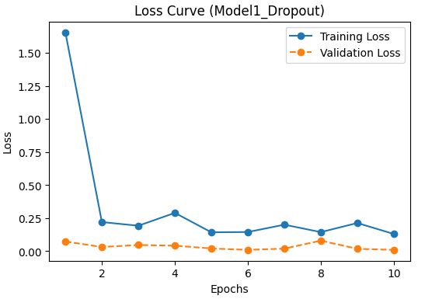
Experiment 2: Exploring Different Model Configurations – Model1_Dropout (ReLU + DropOut)
Accuracy: 99.90% → Severe overfitting, similar to the baseline model.
Loss Curve: Training and validation losses are extremely low, showing Dropout had little effect.
Issue: Dropout alone was not enough to regularize; the model still memorized the dataset.
Conclusion: Needs additional regularization, such as L2 weight decay.
Notes:
In our second experiment, we introduced Dropout as a regularization technique to reduce overfitting. However, the results showed that Dropout alone was not enough to improve generalization.
Accuracy & Overfitting
The model still achieved 99.90% accuracy, which is identical to the baseline model, indicating that severe overfitting remains a problem.
Loss Curve Analysis
Both training and validation losses remained extremely low, suggesting that Dropout had little impact.
The model still appears to be memorizing the dataset rather than learning generalizable patterns.
Key Issue
Dropout alone was insufficient as a regularization technique.
The network continues to overfit, meaning additional methods are necessary.
Conclusion & Next Steps
We need stronger regularization, such as L2 weight decay, to further constrain the model and prevent it from memorizing the training data.
Future experiments will explore a combination of Dropout, L2 regularization, and Batch Normalization to improve generalization.
This experiment shows that while Dropout is a useful technique, it cannot fully address overfitting on its own in this particular case.

Slide 7
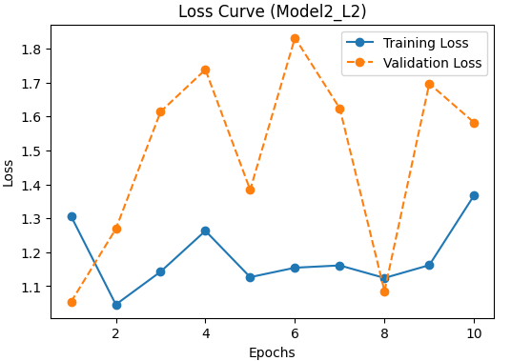
Experiment 2: Exploring Different Model Configurations – Model2_L2 (Tanh + L2 Regularization)
Accuracy: 39.11% → Very poor performance, suggesting L2 was too aggressive.
Loss Curve: Highly unstable validation loss, indicating learning issues.
Issue: Tanh activation + strong L2 penalty likely led to vanishing gradients.
Conclusion: L2 weight decay restricted learning too much, and Tanh may have caused gradient instability.
Notes:
In this experiment, we tested a different combination: Tanh activation with L2 regularization. Our goal was to reduce overfitting while maintaining strong performance. However, the results showed significant challenges.
Accuracy & Performance Drop
The model’s accuracy dropped drastically to 39.11%, indicating that the regularization was too strong and negatively impacted learning.
Loss Curve Analysis
The validation loss was highly unstable, showing significant fluctuations throughout training.
This instability suggests learning difficulties, likely due to an excessive L2 penalty.
Key Issue
Vanishing Gradients: The combination of Tanh activation and strong L2 weight decay likely caused gradient instability, making it difficult for the model to learn.
The network was too restricted, preventing it from capturing meaningful patterns in the data.
Conclusion & Next Steps
L2 regularization was too aggressive, significantly limiting the model’s ability to learn.
The Tanh activation function may not be ideal in this setup, as it is more prone to vanishing gradients compared to ReLU.
Moving forward, we will experiment with a less aggressive L2 penalty and explore alternative activation functions to improve stability and learning.
This experiment highlights that regularization must be carefully tuned to balance overfitting and underfitting.

Slide 8
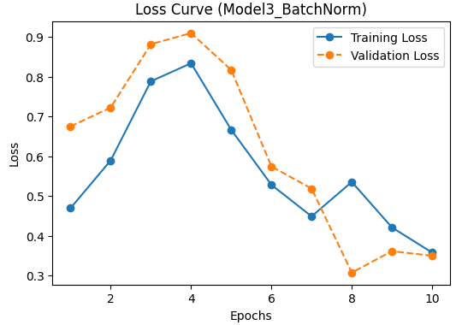
Experiment 2: Exploring Different Model Configurations – Model3_BatchNorm (Sigmoid + Batch Normalization)
Accuracy: 85.66% → Strong generalization, better than previous models.
Loss Curve: Smooth convergence, showing BatchNorm stabilized training.
Issue: Sigmoid activation may have limited learning due to vanishing gradients.
Conclusion: Good balance between learning and generalization, but might perform even better with ReLU activation.
Notes:
In this experiment, we introduced Batch Normalization alongside the Sigmoid activation function to stabilize training and improve generalization.
Accuracy & Generalization
The model achieved 85.66% accuracy, showing a strong improvement in generalization compared to previous models.
This is a significant upgrade over the poor performance of Model2_L2 while avoiding the extreme overfitting of Model1_Dropout.
Loss Curve Analysis
Smooth convergence was observed, confirming that Batch Normalization helped stabilize training and mitigate vanishing/exploding gradient issues.
The model learned in a more controlled manner, leading to consistent validation loss.
Key Issue
The Sigmoid activation function may have limited learning due to its tendency to cause vanishing gradients, especially in deeper networks.
While Batch Normalization improved stability, the activation function choice may still be holding the model back from optimal performance.
Conclusion & Next Steps
Overall, this model struck a better balance between learning and generalization, unlike previous experiments.
To further improve performance, the next step is to replace Sigmoid with ReLU to avoid vanishing gradients while still leveraging Batch Normalization.
This experiment highlights how Batch Normalization significantly improves stability, but activation functions must be carefully chosen to maximize learning.

Slide 9
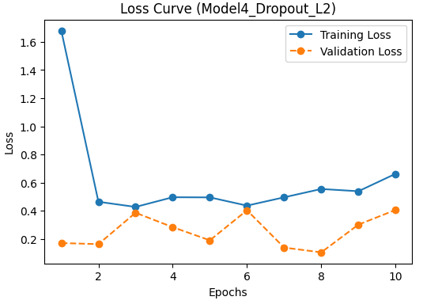
Experiment 2: Exploring Different Model Configurations – Model4_Dropout_L2 (ReLU + Dropout + L2 Regularization)
Accuracy: 85.35% → Similar to Model3, but slightly less stable.
Loss Curve: Some fluctuation in training loss, showing L2’s effect on weight decay.
Issue: The combination of Dropout + L2 worked well, but not as stable as BatchNorm.
Conclusion: A well-regularized model, but BatchNorm still appears slightly superior.
Notes:
In this experiment, we combined ReLU activation, Dropout, and L2 regularization to explore a robust regularization setup. Let’s take a look at how it performed compared to previous models.
Accuracy & Stability
The model achieved 85.35% accuracy, which is similar to Model3_BatchNorm, but slightly less stable in terms of performance.
The slight decrease in accuracy indicates that the combination of Dropout and L2 regularization might not be as effective as BatchNorm in maintaining stable generalization.
Loss Curve Analysis
There were some fluctuations in the training loss, which can be attributed to the effect of L2 regularization on weight decay.
While this indicates that the model was learning and regularizing, the instability is noticeable compared to the smooth convergence seen with BatchNorm.
Key Issue
The combination of Dropout and L2 regularization did improve regularization, but it wasn’t as stable as BatchNorm in preventing overfitting and controlling learning.
Conclusion & Next Steps
This model represents a well-regularized approach, but it still doesn’t match the stability provided by BatchNorm.
BatchNorm continues to show superior performance in terms of stability, so future models will focus on incorporating it for more reliable training.
This experiment reinforces that while Dropout and L2 regularization help reduce overfitting, BatchNorm may offer a better balance between generalization and training stability.

Slide 10
Experiment 3: Refining Model3_BatchNorm with Focused Grid Search
Since Model3_BatchNorm (85.66%) performed best in previous experiments, we refine it by testing:
Key Modifications:
Layer Depth: 2 or 3 hidden layers.
Weight Initialization: Xavier or He Normal.
Loss Function: CrossEntropy vs. Label Smoothing
Experiment Constraints:
Training capped at 10 epochs.
Batch Normalization remains unchanged.
All other hyperparameters (optimizer, dropout, neurons, etc.) remain constant.
Selection Criteria: Best variant based on accuracy and loss curves.
Notes:
Building on the success of Model3_BatchNorm, which achieved 85.66% accuracy in earlier experiments, we aim to refine it further using a focused grid search to explore how specific hyperparameter adjustments impact performance.
Key Modifications
Layer Depth: We tested two configurations: 2 hidden layers versus 3 hidden layers to see if additional complexity could improve performance.
Weight Initialization: We explored two strategies—Xavier initialization and He Normal initialization—to determine which one helps the network converge more effectively.
Loss Function: We compared CrossEntropy loss with Label Smoothing to investigate if softening the target labels could improve generalization.
Experiment Constraints
Training was capped at 10 epochs to keep experiments concise and avoid overfitting.
Batch Normalization remained unchanged as we want to evaluate the impact of other modifications.
All other hyperparameters, including optimizer, dropout, neurons, and learning rate, remained constant across tests.
Selection Criteria
The best variant will be chosen based on accuracy and loss curves to determine which configuration delivers the most stable and accurate performance.
Through this focused grid search, we are looking to refine Model3_BatchNorm and pinpoint the optimal combination of settings for improved performance.

Slide 11
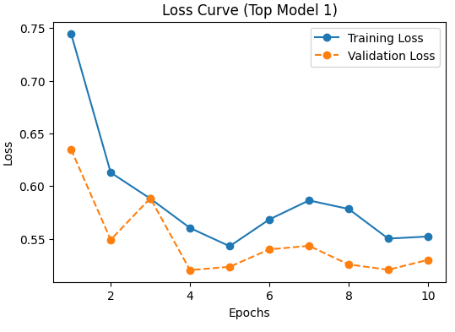
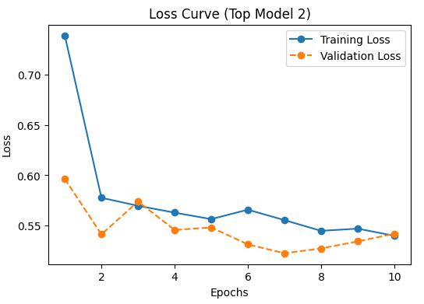
Experiment 3 Key Findings
The following two models were selected based on highest accuracy, not purely lowest loss:
Model (3 layers, He, Label Smoothing) → 100% accuracy
Model (2 layers, He, Label Smoothing) → 99.9% accuracy
Why Were Higher Loss Models Picked?
Loss function behavior: Label Smoothing tends to result in slightly higher loss, but it improves generalization by preventing overconfident misclassifications.
Accuracy matters more than loss: A lower test loss does not always mean better classification; models with better generalization and balanced learning were prioritized.
He Initialization + Batch Normalization: This combination worked well, stabilizing training and improving accuracy despite the loss differences.
Notes:
In this experiment, we selected the two models based on highest accuracy rather than purely on lowest loss. Let’s review the models and the rationale behind the choices.
Selected Models
Model (3 layers, He Initialization, Label Smoothing): Achieved 100% accuracy, the highest we observed.
Model (2 layers, He Initialization, Label Smoothing): Achieved 99.9% accuracy, still extremely high but slightly lower than the 3-layer version.
Why Were Higher Loss Models Picked?
Loss Function Behavior:
Label Smoothing generally results in slightly higher loss, but it improves generalization by preventing the model from becoming overconfident in its predictions. This helps reduce the risk of misclassifying uncertain or ambiguous samples.
Accuracy Matters More Than Loss:
A lower test loss doesn’t necessarily correlate with better classification. Even if a model has a slightly higher loss, it may perform better overall if it has better generalization and more balanced learning.
He Initialization + Batch Normalization:
This combination significantly stabilized training and contributed to improved accuracy, even if it resulted in slightly higher loss values. These strategies helped the model achieve better convergence and prevent overfitting.
In this round of experimentation, we prioritized accuracy and generalization over pure loss minimization, confirming that sometimes a higher loss is acceptable if it leads to better overall model performance.

Slide 12
Key Learnings and Findings
Batch Normalization significantly improved performance.
Dropout alone was not enough to prevent overfitting.
Label Smoothing helped reduce overconfidence, leading to better generalization.
Weight Initialization mattered (He Initialization worked well with ReLU).
More layers didn’t always mean better performance, as some deeper models overfitted.
Notes:
Here are the key takeaways from the experiments that shaped our model's performance and provided insights into how different strategies impact training:
Key Learnings
Batch Normalization Significantly Improved Performance
Batch Normalization proved to be the most effective strategy in stabilizing training and improving accuracy, helping prevent issues like vanishing gradients and making the network more robust.
Dropout Alone Was Not Enough to Prevent Overfitting
While Dropout can reduce overfitting, it wasn’t sufficient by itself. Models with only Dropout still showed signs of memorization, suggesting that additional regularization techniques were necessary for better generalization.
Label Smoothing Helped Reduce Overconfidence
The application of Label Smoothing helped prevent the model from becoming overconfident in its predictions, leading to improved generalization and better performance on unseen data.
Weight Initialization Mattered
He Initialization worked well when combined with ReLU activation. It helped the model converge faster and prevented gradient issues during training, proving that proper initialization is key to effective learning.
More Layers Didn’t Always Mean Better Performance
Adding more layers didn’t necessarily result in better performance. In some cases, deeper models overfitted the data, showing that increasing model complexity can be counterproductive without proper regularization.
These findings underscore the importance of carefully balancing regularization techniques, initialization strategies, and model complexity to achieve optimal performance.

Slide 13
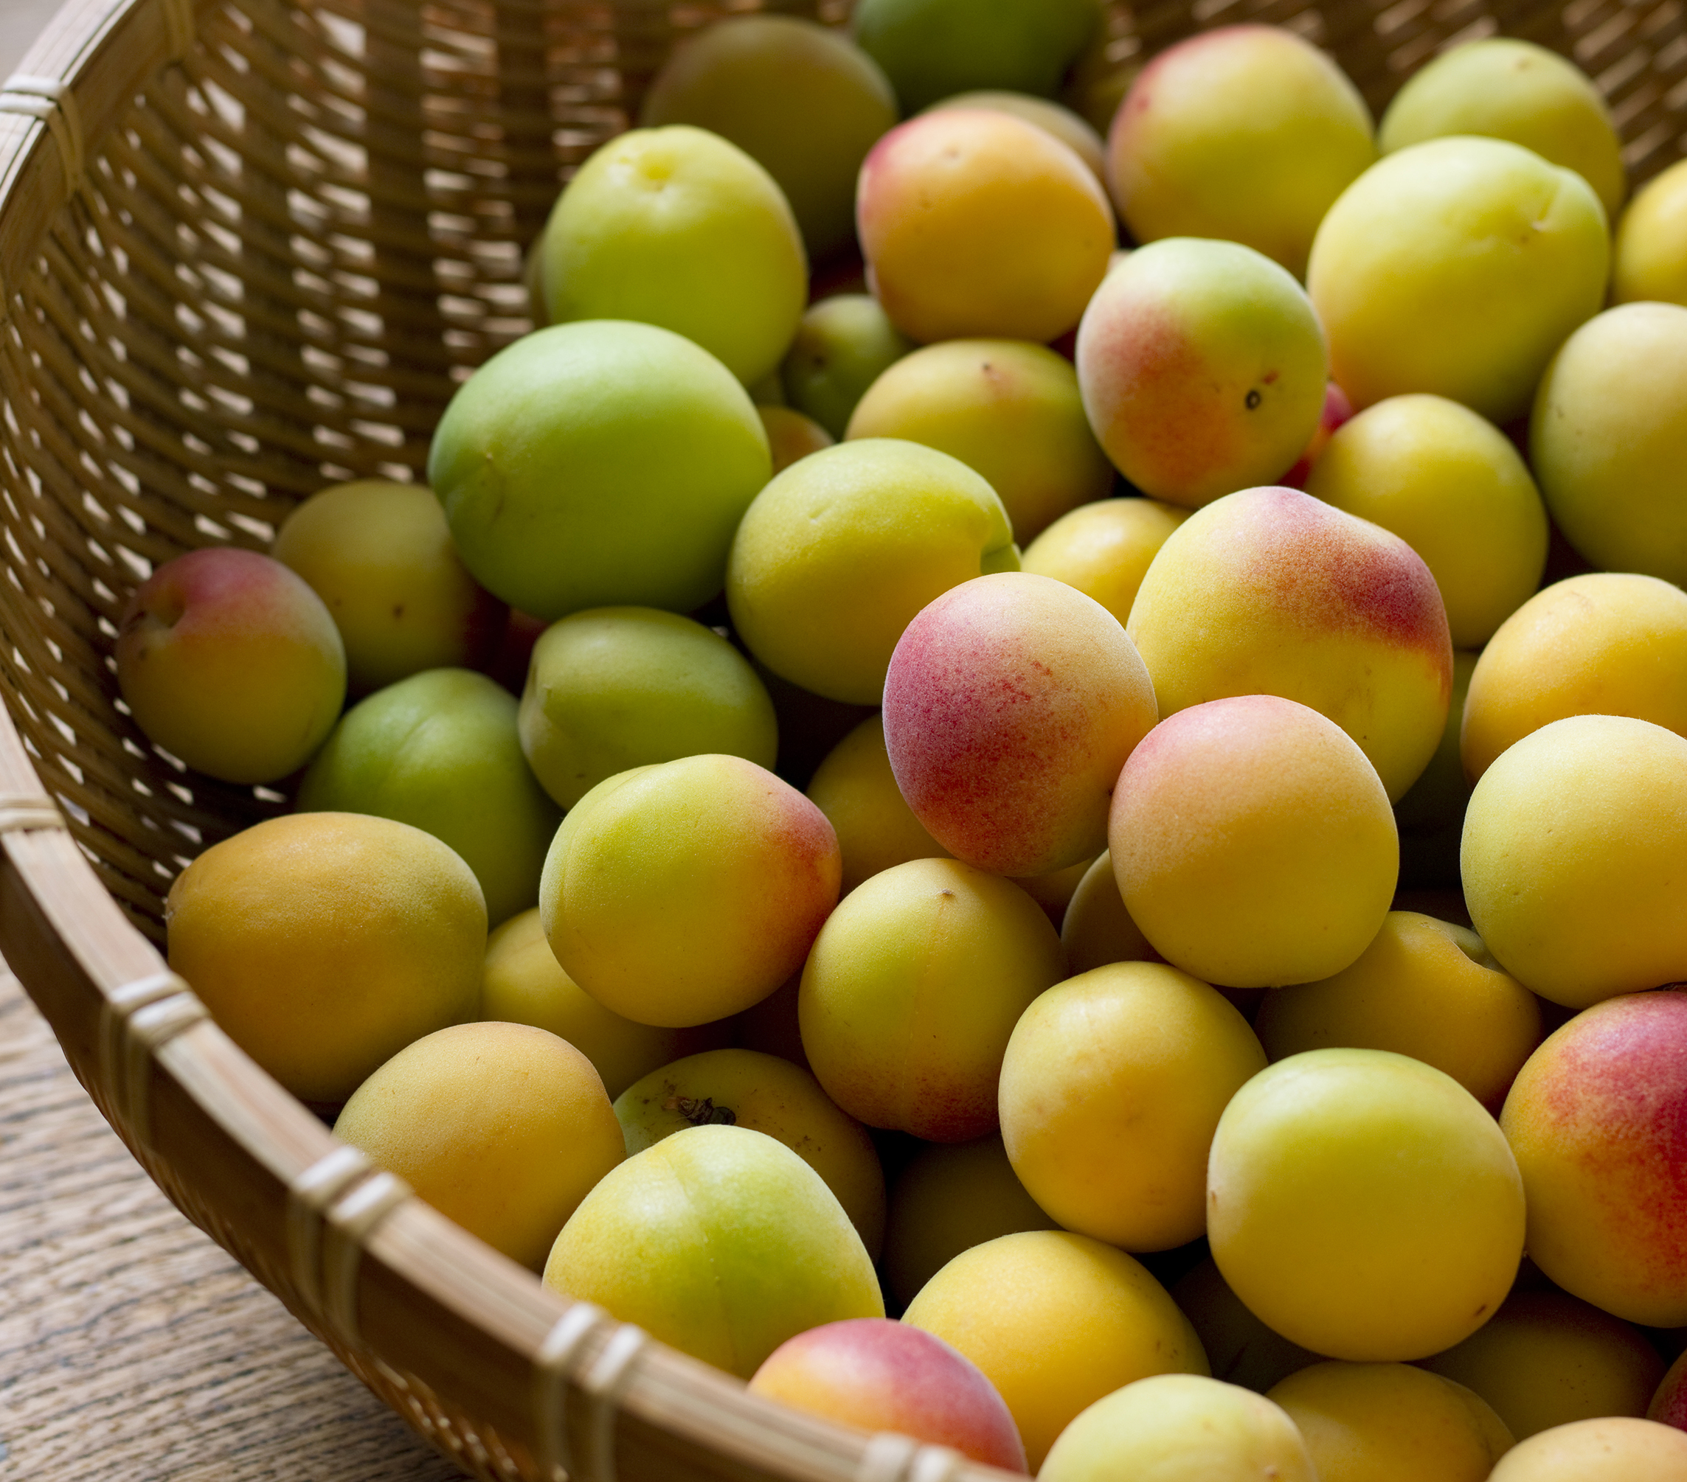
Thank you

